Slide 1
Clean Air Act
By: Alyssa Gibson, Kaitlyn Smith, Ben Russell & Cedric Sanders

Slide 2
Events Leading Up to the Clean Air Act
New York City Air Inversion
California set standards on emissions of automotives
Environmental Protection Agency (EPA)
Cleaning up the Great Lakes
Oregon law required the returning of bottles and cans

Slide 3
New York City Air Inversion

Slide 4
Laws Intending to Reduce Pollution Levels
Refuse Act
Air Quality Control Act
Noise Control Act
Safe Drinking Water Act
Clean Air Act

Slide 5
Focus Question:
What gives the federal government the right to be able to stop big businesses from carrying out the way they perform activities?

Slide 6
Emission Standards set by EPA and US
These are the National Ambient Air Quality Standards set by the EPA for the six principal air pollutants:
Carbon Monoxide, Lead, Nitrogen Dioxide, Ozone, Particle Pollution, and Sulfur Dioxide

Slide 7
Federal Law
The Clean Air Act was one of the first Federal laws put into place that dealt with the environment and pollution
Regulates air emissions from mobile and stationary sites
Meant to protect public health and public welfare to regulate emissions of hazardous air pollutants
"Major sources" are defined as a stationary source or group of stationary sources that emit or have the potential to emit 10 tons per year or more of a hazardous air pollutant or 25 tons per year or more of a combination of hazardous air pollutants
Major Sources are controlled by the EPA, which have established emission standards that require the maximum degree of reduction in emissions of hazardous air pollutants
Regular investigations and inspections are conducted to maintain compliance
Ocean-going vehicles and large ships are also subject to the Clean Air Act
Assistance is provided to help industries meet regulations to avoid shut-down
Federal Intervention is justified by the common good

Slide 8
Video

Slide 9
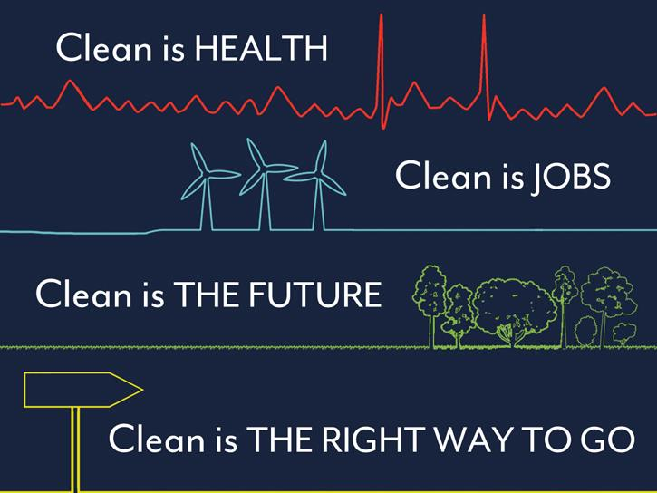
Major states involvement:
Kansas- authorized the state to carry out a plan, must hold a hearing with the State Corporation Commission, established a study committee
Colorado- wants to initiate a Clean Power Plan & cost should be paid for by funds & must develop state plans within a hearing
Florida- this state isn't allowed to submit a state plan, Congress must enact limited power plant CO2 emissions before the state can request / do anything
Virginia- wanted to achieve a state plan & achieve a resolution with the Legislature, wanted to create general funds for the state plan

Slide 10
Change in Coal Mining Employment:
This graph shows the changes in the coal mining employment before and after the Environmental Protection Agency (EPA) came in to help stop pollution.

Slide 11
Major States Involvement:
Alabama- the state of Alabama wants to protect its sovereignty by leaving the decision of the air pollution control & prevention out of the hands of the federal government
Washington- believes it is in the best interest of the Department of Ecology to file an initial state plan on greenhouse gas emissions with a request for a two year extension
Maryland- the state government works aggressively to place numerous regulations on the control of air pollution within its borders
*Maryland's Healthy Air Act is the toughest power plant emission law on the East Coast*
Wyoming- the state prohibits the Department of Environmental Quality from using state funds to create a new plan as long as the Supreme Court's is still in effect

Slide 12
Statistics

Slide 13
Sources
https://www.epa.gov/clean-air-act-overview/clean-air-act-partnership-among-governments
http://www.ncsl.org/research/energy/states-reactions-to-proposed-epa-greenhouse-gas-emissions-standards635333237.aspx
https://www.epa.gov/criteria-air-pollutants/naaqs-table
http://sks.sirs.com/webapp/article?artno=0000280365&type=ART
http://www.kdheks.gov/environment/servguid.html
https://www.colorado.gov/pacific/sites/default/files/HM_env-spill-reporting-guide.pdf
http://www.mde.state.md.us/programs/Air/Documents/GoodNewsReport/GoodNewsReport2015Final.pdf
http://www.dep.state.fl.us/Air/rules/flstatutes.htm
http://www.deq.virginia.gov/Programs/Air.aspx

