Slide 1
The Clean Air act
Matthew LaBille, Destiny Johnson, Jackie Teachout, Trent Turpin

Slide 3
Federal Law
Clean air act was the first major environmental federal law
It was passed in 1963
Clean Air Act amendments of 1970 are the basis of today
In 1990 it was even furthered by acid rain and ozone depletion.

Slide 4
Amendments
1977, extended deadlines for areas to achieve a certain air quality depending on there area but also made it more strict, also extended the deadline for auto vehicles to make there cars air friendly as well.
In 1990, they extended the deadlines again but in exchange they wanted greater efforts to achieve those goals.

Slide 5
Court cases
Union electric vs. EPA, supreme court ruled states may require air pollution sources to achieve tough emission limits.
Sierra Club vs. Ruckelshaus, Court ruled that the EPA can not approve of state plans unless it covered existing act.
In Ethyl Corp. vs. EPA, the U.S. Court of Appeals for the District of Columbia Circuit held that the EPA could regulate a substance even though it could not be proved that the substance was harmful.

Slide 6
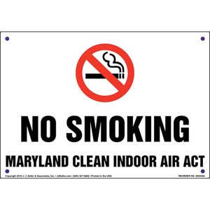
Maryland's Clean Indoor Air act
Signed into law may 17 2007
Not aloud to smoke in public meeting areas, Public transportation, and places of indoor employment
Reasons why people cant smoke in public places due to the fact of personal health of the people near the smoker

Slide 7
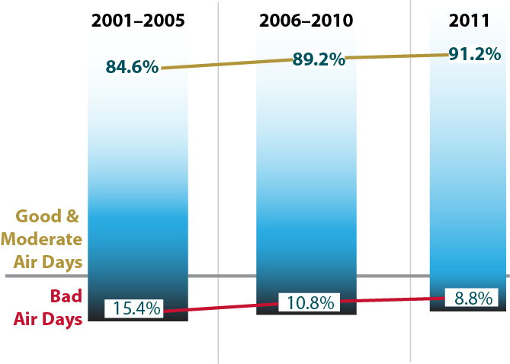
Maryland's Healthy air act
The healthy air act is the toughest power plant emissions law on the east cost.
The healthy air act requires the reduction of nitrogen oxide, sulfur dioxide and mercury emissions

Slide 8
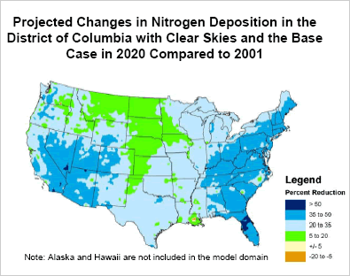
Suing THE GOVERNMENT?
THE DISTRICT OF COLUMBIA WAS NOT FOUND ABOUT THE CLEAN AIR ACT
THEY BELIEVED THAT THE ACT WOULD SHARPLY WEAKEN THE AOR POLLUTION PROTECTIONS DRASCTICALLY
ALTIMATLY LEADING TO A DAMAGE TO THE ENVIORMENT AND PUBLIC HEALTH

Slide 9
State responses of the clean air act
States adopted enforceable plans to reduce pollutants that damage visibility in national parks and other protected areas.
States also established the Title V Operating Permit Program as a part of the 1990 clean air act amendments.

Slide 10
Amendments:
Developed state implementation plans (SIP'S)- was amended in 1977
CAA established a risk- based program (risk management plan rule)
MACT (Maximum achievable control technology standards) ; established emission standards that require the maximum degree of reduction in emissions of hazardous air pollutants
NAAQS (National Ambient Air Quality Standards)

Slide 11
Sources:
http://phpa.dhmh.maryland.gov/OEHFP/EH/Pages/clean-indoor-act.aspx
http://thehill.com/blogs/pundits-blog/energy-enviornment/207683-keeping-cooperation-in-cooperative-federalism
https://www.epa.gov/laws-regulations/summary-clean-air-act
https://www.epa.gov/title-v-operating-permits
http://www.ag.ny.gov/press-release/states-sue-federal-government-protect-clean-air-act
http://www.mde.maryland.gov/programs/air/pages/md_haa.aspx

